Slide 1


CHATBOT ANSWERING SIMPLE QUESTIONS USING DEEP LEARNING
USING RULE-BASED LOGIC BY PREDEFINED Q/A ,
AND DYNAMICALLY BY USING GEMINI GPT-3
This Photo by Unknown Author is licensed under CC BY

Slide 2
LIST OF CONTENTS
Introduction
Project Overview
Features
System Architecture
Input Module
Processing Module
Output Module
Key Benefits
User Experience
Use Cases
Future Enhancements
Conclusion

Slide 3

INTRODUCTION
Objective: Develop a chatbot to answer predefined questions.
Target Audience: Users seeking quick, accurate answers.
Project Scope: Focus on rule-based logic.
Tools and Technologies: Overview of tools used.
Importance: Enhances user experience.

Slide 4

PROJECT OVERVIEW
Scope: Handles predefined questions.
Technology: Implemented using Python.
Logic: Rule-based for accurate responses.
Components: Input, Processing, Output modules.
Project Duration: Timeline and milestones.

Slide 5
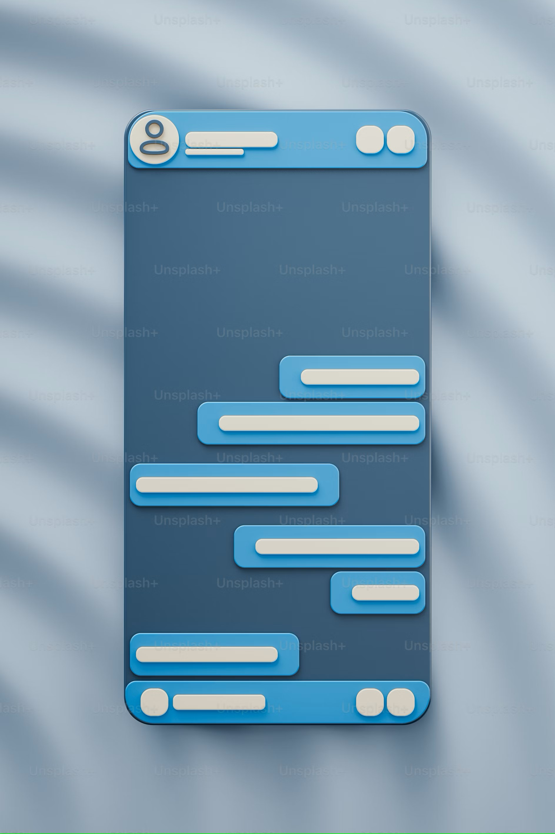
FEATURES
Simple Interaction: Easy to use.
Quick Responses: Immediate answers.
Predefined Logic: Ensures accuracy.
User Friendly: Intuitive interface.
Scalable: Can handle increasing queries.

Slide 6
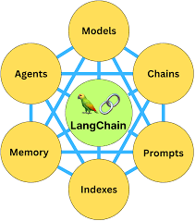
SYSTEM ARCHITECTURE
Components: Input, Processing, Output modules.
Flow: User input to response generation.
Technology Stack: Python, GPT-3
Integration: Seamless data flow between modules.
Reliability: Robust design.

Slide 7
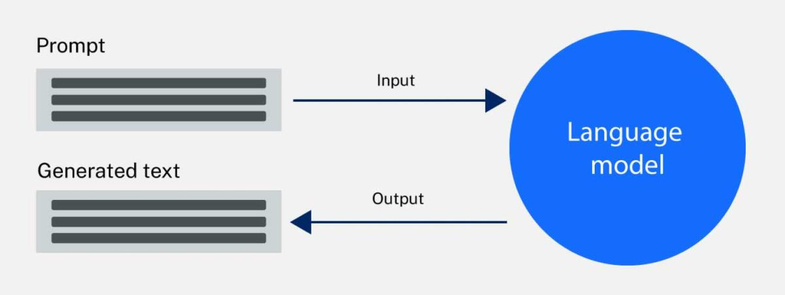
INPUT MODULE
User Interface: Text input field.
Submit Button: Initiates query processing.
Data Validation: Ensures correct input format.
Example Query: User types a question.
Usability: Designed for easy interaction.

Slide 8
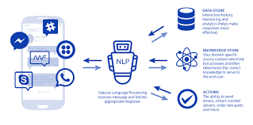
PROCESSING MODULE
Logic Implementation: Rule-based matching.
Pattern Matching: Using regex for identification.
Keyword Identification: Key terms extraction.
AI Fallback: Google Generative AI for unknown queries , Predefined Q/A for Rule based Chatbot
Efficiency: Fast processing.

Slide 9
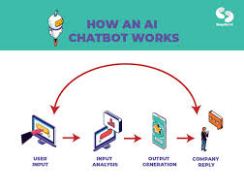
OUTPUT MODULE
Response Generation: Producing accurate replies.
Display: Showing concise answers.
User Feedback: Collecting feedback on responses.
Example Response: Demonstration of output.
Adaptability: Adjusts to new queries.

Slide 10
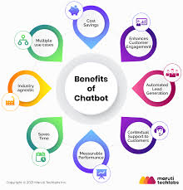
KEY BENEFITS
Efficiency: Reduces response time.
Accuracy: Provides correct answers.
User Satisfaction: Enhances engagement.
Cost-Effective: Reduces need for human agents.
Scalable: Handles increasing volumes.

Slide 11
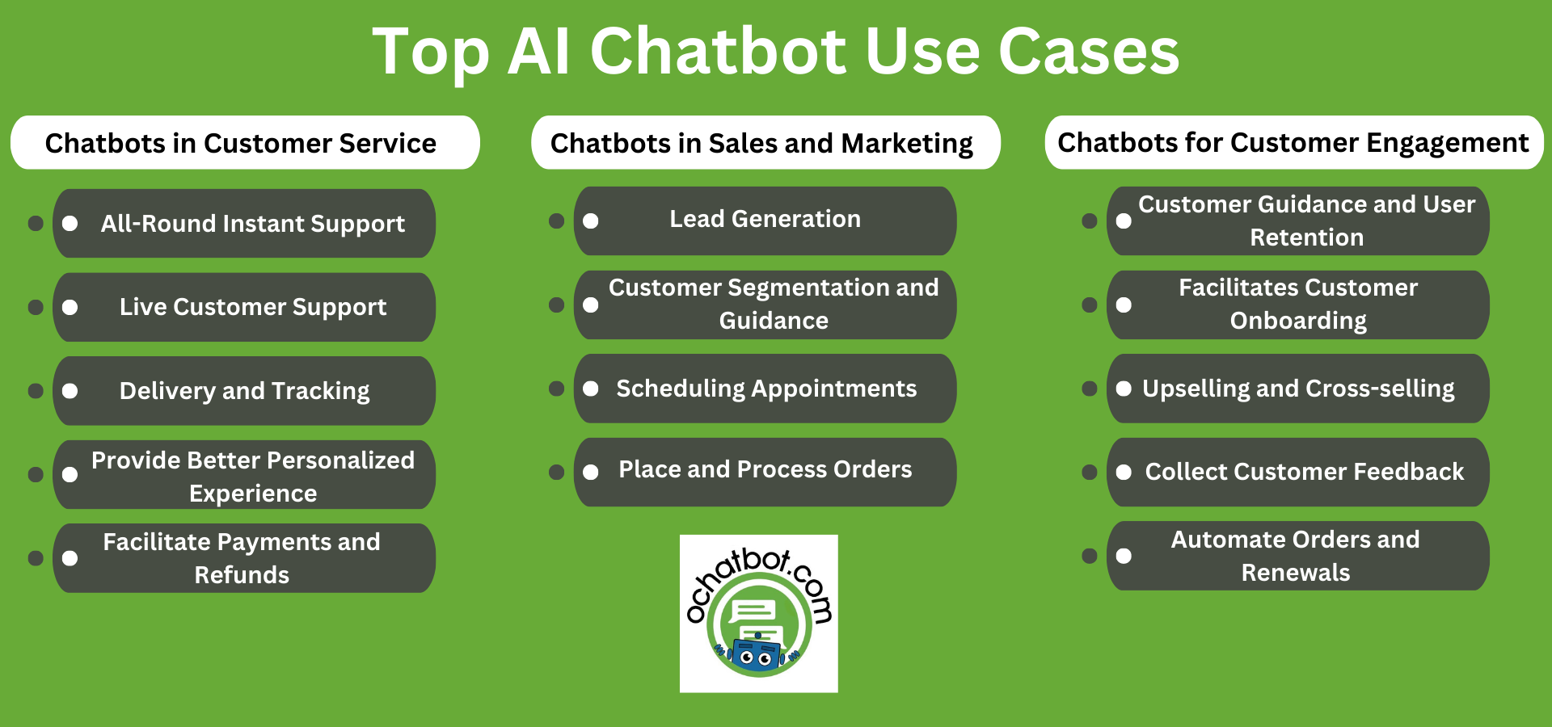
USE CASES
Customer Support: Answering FAQs.
Internal Tools: Employee self-service.
Education: Providing instant information.
Healthcare: Basic medical queries.
Retail: Product information and support.

Slide 12
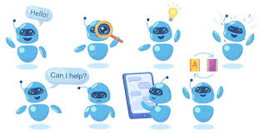
FUTURE ENHANCEMENTS
Scalability: Expanding question database.
AI Integration: Incorporating machine learning.
Personalization: Customizing responses.
Voice Integration: Adding voice capabilities.
Multilingual Support: Supporting multiple languages.

Slide 13
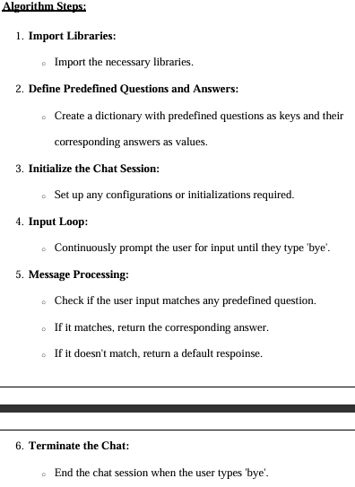
ALGORITHM USED

Slide 14
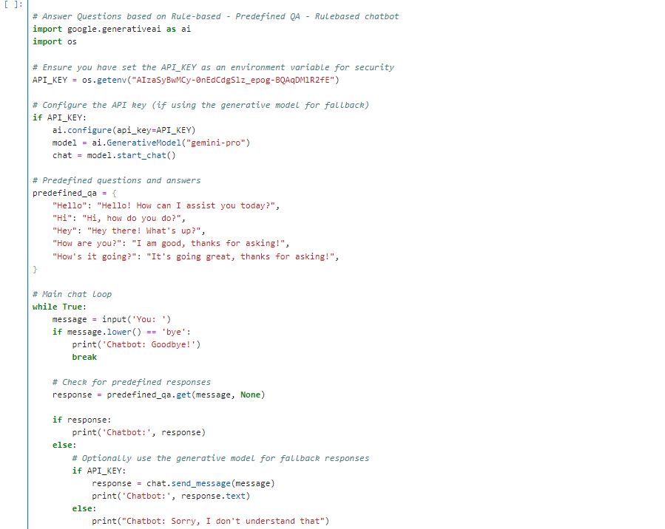
PSEUDOCODE ( RULEBASED )

Slide 15
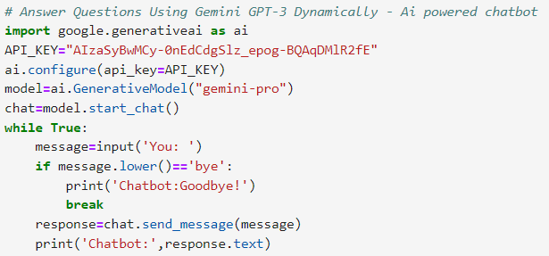
PSEUDOCODE (AI-POWERED CHATBOT)

Slide 16
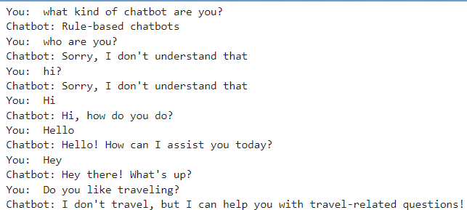
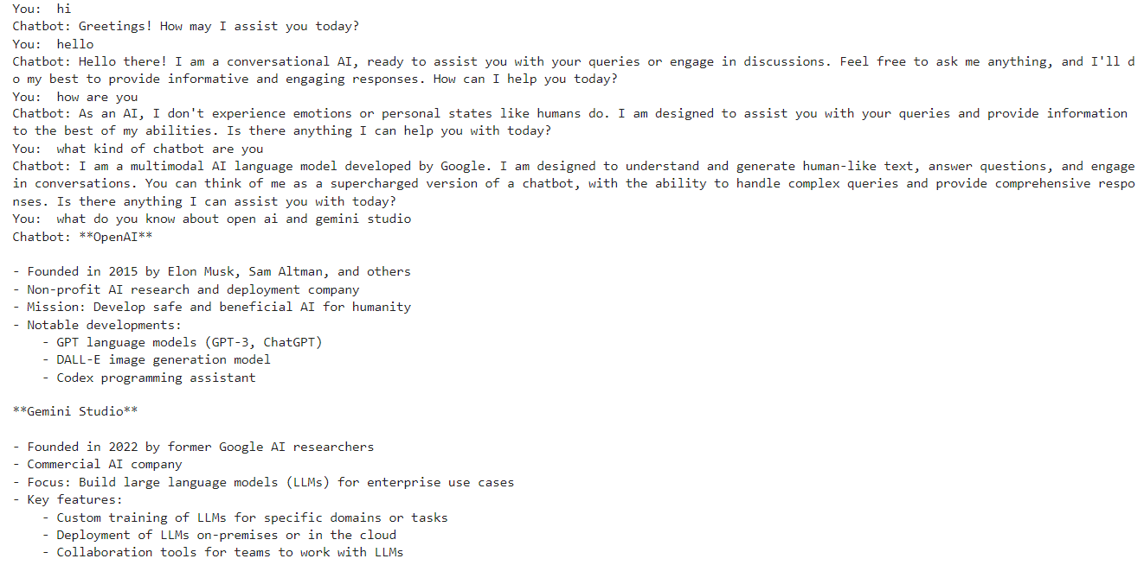
INPUTS AND OUTPUTS FOR PSEUDOCODE

Slide 17
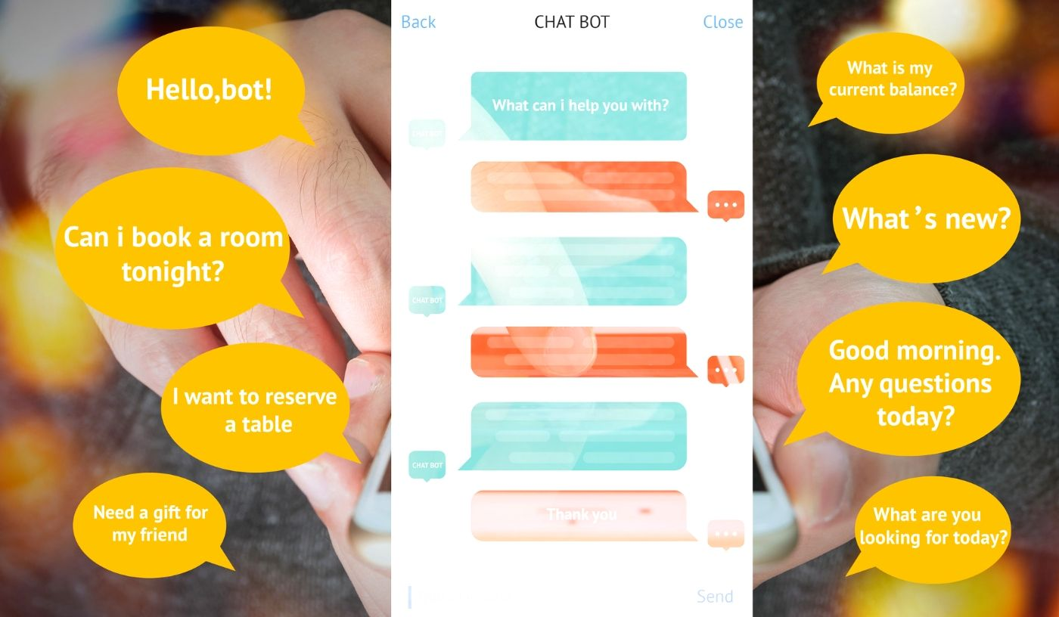
CONCLUSION
Summary: Successful development of a chatbot.
Benefits: Efficiency, accuracy, user satisfaction.
Implementation: Ready for deployment.
Next Steps: User testing and feedback.
Q&A: Invite audience questions.

Slide 18

PRESENTED BY
NAME: PATAN NAGOOR VALI
REGD NO: 21HU1A4279 COLLEGE : RVIT ENGINEERING COLLEGE(FORMERLY CHEBROLU ENGINEERING COLLEGE)

